Slide 1

Unit 2
I think that mooncakes are
delicious!
Section B 1a-1d
第一PPT模板网-WWW.1PPT.COM

Slide 2
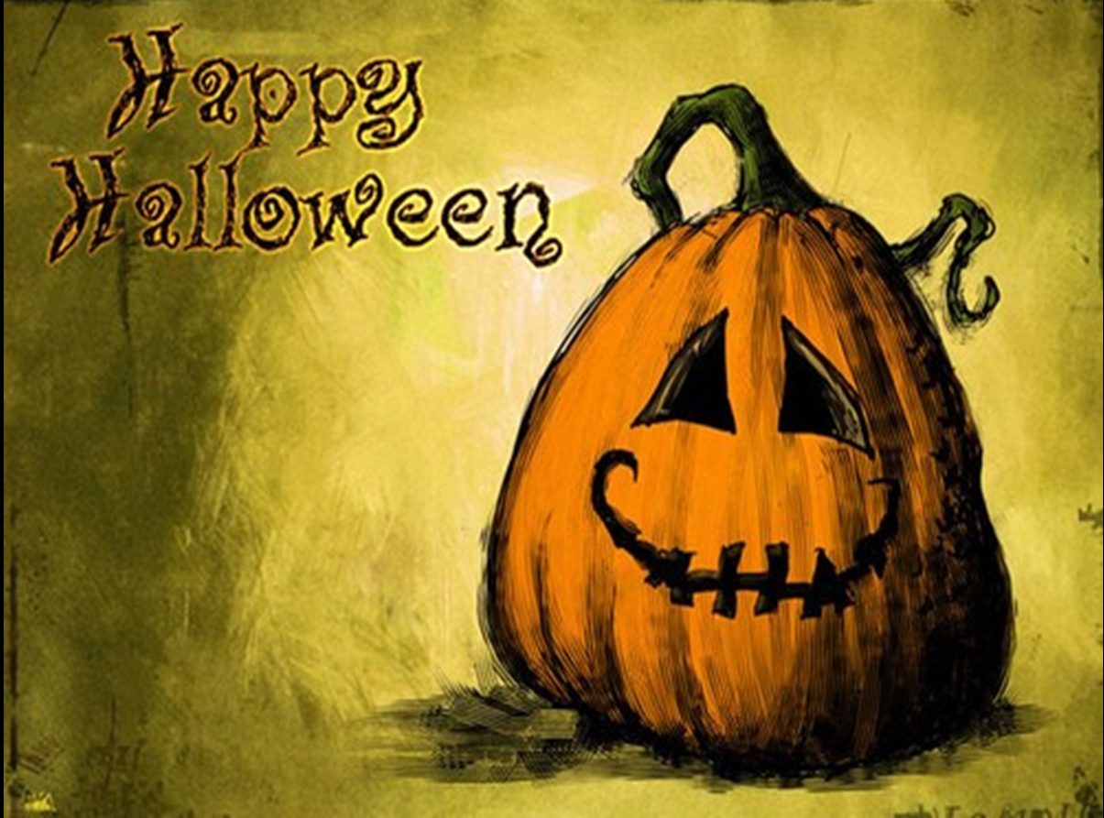
Do you know something
about Halloween?

Slide 3
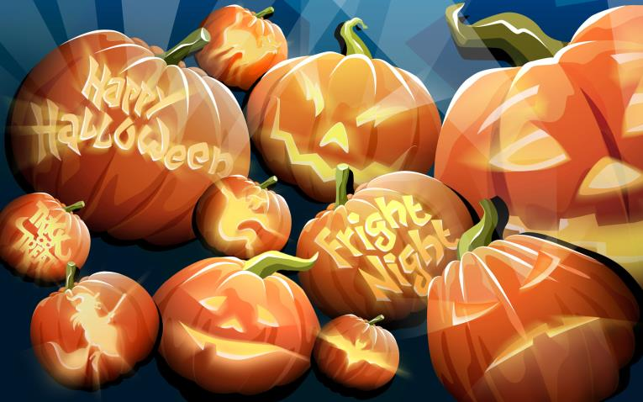
make pumpkin lanterns

Slide 4
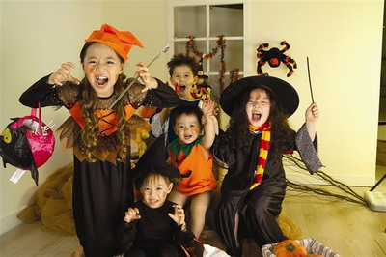
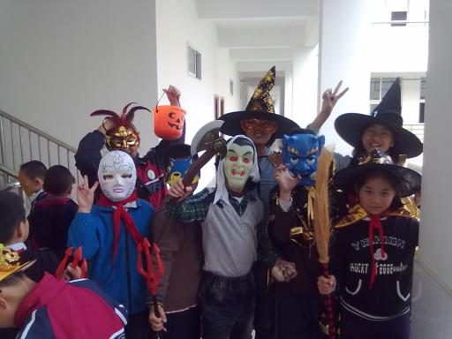
dress up and wear masks

Slide 5
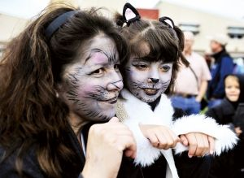
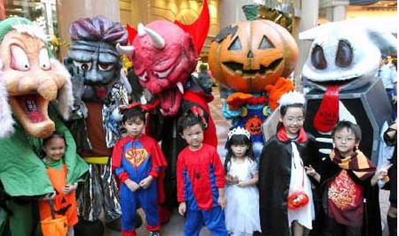
have a special party
paint the faces
PPT模板：www.1ppt.com/moban/ PPT素材：www.1ppt.com/sucai/
PPT背景：www.1ppt.com/beijing/ PPT图表：www.1ppt.com/tubiao/
PPT下载：www.1ppt.com/xiazai/ PPT教程： www.1ppt.com/powerpoint/
资料下载：www.1ppt.com/ziliao/ 范文下载：www.1ppt.com/fanwen/
试卷下载：www.1ppt.com/shiti/ 教案下载：www.1ppt.com/jiaoan/
PPT论坛：www.1ppt.cn PPT课件：www.1ppt.com/kejian/
语文课件：www.1ppt.com/kejian/yuwen/ 数学课件：www.1ppt.com/kejian/shuxue/
英语课件：www.1ppt.com/kejian/yingyu/ 美术课件：www.1ppt.com/kejian/meishu/
科学课件：www.1ppt.com/kejian/kexue/ 物理课件：www.1ppt.com/kejian/wuli/
化学课件：www.1ppt.com/kejian/huaxue/ 生物课件：www.1ppt.com/kejian/shengwu/
地理课件：www.1ppt.com/kejian/dili/ 历史课件：www.1ppt.com/kejian/lishi/
Notes:
PPT模板：www.1ppt.com/moban/ PPT素材：www.1ppt.com/sucai/
PPT背景：www.1ppt.com/beijing/ PPT图表：www.1ppt.com/tubiao/
PPT下载：www.1ppt.com/xiazai/ PPT教程： www.1ppt.com/powerpoint/
资料下载：www.1ppt.com/ziliao/ 范文下载：www.1ppt.com/fanwen/
试卷下载：www.1ppt.com/shiti/ 教案下载：www.1ppt.com/jiaoan/
PPT论坛：www.1ppt.cn PPT课件：www.1ppt.com/kejian/
语文课件：www.1ppt.com/kejian/yuwen/ 数学课件：www.1ppt.com/kejian/shuxue/
英语课件：www.1ppt.com/kejian/yingyu/ 美术课件：www.1ppt.com/kejian/meishu/
科学课件：www.1ppt.com/kejian/kexue/ 物理课件：www.1ppt.com/kejian/wuli/
化学课件：www.1ppt.com/kejian/huaxue/ 生物课件：www.1ppt.com/kejian/shengwu/
地理课件：www.1ppt.com/kejian/dili/ 历史课件：www.1ppt.com/kejian/lishi/

Slide 6
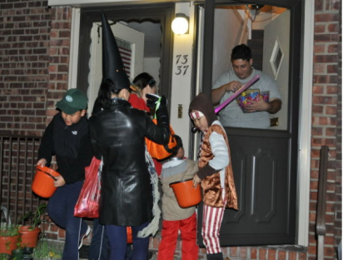
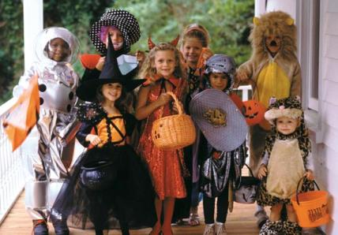
Play a game called ‘trick or treat’
knock on the door
ask for candies and
treats
“If you do not give us a treat,
we can play a trick on you.”

Slide 7
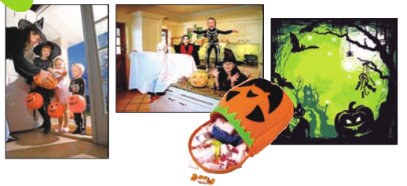
1a Look at the pictures and words related to Halloween. What do you think this festival is about?
scary dress up haunted house
black cat candy trick or treat
ghost October spider

Slide 8
1b. Listen and answer the questions.
1. Where is Halloween popular?
2. When do people celebrate Halloween?
3. What does Wu Yu think of this festival?
In north America.
On October 31st.
She thinks it is quite a scary but
really fun festivals.

Slide 9
1c Listen and fill in the blanks.
1. Many people make their _______look scary. They may ________ the lights and light candles. They sometimes also put things like spiders and ghosts around the doors and___________.
2. Little kids and even parents _________as ghosts or black cats. They can also dress up
as fun things like________ characters.
houses
turn off
windows
dress up
cartoon

Slide 10
3. Parents take their children around the
neighborhood to ask for________ and
treats.
4. “Trick or treat” means kids will _______a
trick on you if you don’t ________ them
a treat.
candies
play
give

Slide 11
Explanations
1. dress up 装扮;乔装打扮.
Dress up 常与 as, in 连用构成短语：
dress up as… 意为“装扮/乔装打扮成…”
dress up in… 意为“穿上…”后接表示衣服或
颜色的名词。
►He likes to dress up as a soldier.
他喜欢装扮成军人。

Slide 12
►On Christmas Day we always dress up in red.
在圣诞节我们总是穿上红衣服。
辨析：dress, wear, put on, have on 与 be in
Dress “给某人穿衣服”，其宾语是人或 反身代
词，不是表示衣服等的 名词
Wear “穿着；戴着”强调状态
Put on “穿上；戴着”强调动作
Have on “穿着；戴着”强调状态。不能用于被动语态。
Be in “穿着；戴着”强调状态， 通常接表示颜色的名词。

Slide 13
►She dressed her son and then sent him to school.
她给儿子穿好衣服并送他去上学。
►She wears red shoes.
她穿着红色的鞋子。
►He put on his best clothes for the party.
为参加晚会他穿上了最好的衣服。
►She had a beautiful new suit on.
她穿着一套漂亮的新衣服。
►Who is the girl in red over there?
那边穿红衣服的那个女孩是谁？

Slide 14
2. “Trick or treat” means kids will play a
trick on you if you don’t give them a treat.
(1) play a trick on 意为“捉弄”。
►These children love playing tricks on their
teacher. 这些孩子喜欢捉弄他们的老师。
（2) if 意为“如果”，此处用于引导条件状语从句，主句是一般将来时，从句则用一般现在时。
►I will go home if it doesn’t rain tomorrow.
如果明天不下雨，我就回家。

Slide 15
1d Think about the Halloween activities
that interest you most. Discuss what you
have learnt with a partner.
A: What have you learned about Halloween?
B: Oh, I know it’s a popular festivals in
North America and it’s on October 31st.
A: What do you like most about this festival?
B: I think it’s fun to dress up as cartoon
characters!

Slide 16
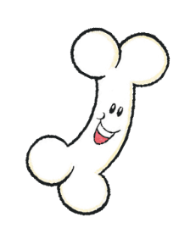
Do you know when these special days
are? Try to match each day with
the correct date.
Christmas Fourth Thursday in November
April Fool’s Day February 14th
Halloween April 1st
St. Valentine’s Day October 31st
Thanksgiving December 25th

Slide 17
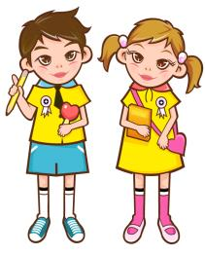
Pairwork
What have you learned about Halloween?
Oh, I know it’s a popular festival in North America and it’s on October 31st.

Slide 18
What do you like most about this festival?
I think it’s fun to dress up as cartoon characters!

Slide 19
Many people make their houses look scary. They turn off the lights and light candles.
What do people do on that day?

Slide 20
What do little kids dress up?
They dress up as ghosts or black cats.

Slide 21
Yes. Children ask their neighbours for candies and treats. If you don’t give them a treat, they will play a trick on you.
Do you know a game called “trick or treat”?

Slide 22
Exercises
1.The question is ____the film is worth seeing．
A. if B. what C. whether D. how
2.One of the men held the view____ the book said was right．
A. that what B. what that
C. that D. whether
C
A

Slide 23
3.They received orders ____ the work be done at once．
A. which B. when C. ／ D. that
4.Dr. Black comes from either Oxford or Cambridge. I can't remember ____.
A. where B. there C. which D. that
D
C

Slide 24
5.Energy is ____ makes things work．
what B. everything
C. something D. anything
6.The reason____ I have to go is ______ my mother is ill in bed．
A. why ; why B. why ; because
C. why ; that D. that ; because
A
C

Slide 25
7.He doesn't think the question of ____ they are men or women is important．
A. whether B. if C. which D. why
8.He often thinks of ____ he can do more for his country．
A. what B. how C. that D. which
A
A

Slide 26
9.It was ordered that all the soldiers ____ to the front．
A. should send B. must be sent
C. should be sent D. must go
10.Air is to us ____ water is to fish．
A. is that B. what
C. which D. that
B
B

Slide 27
1. Review the next part .
2. Remember the new words and expressions.

Slide 28
Thank You!

